Slide 1
SUSTAINABLE ENERGY AND GDP PER CAPITA

Slide 2




TEAM MEMBERS
Marc Machado
Yu Min Chang
Abdul Haleem
Yujin Im

Slide 3
DATA CLEANING
1

Slide 4
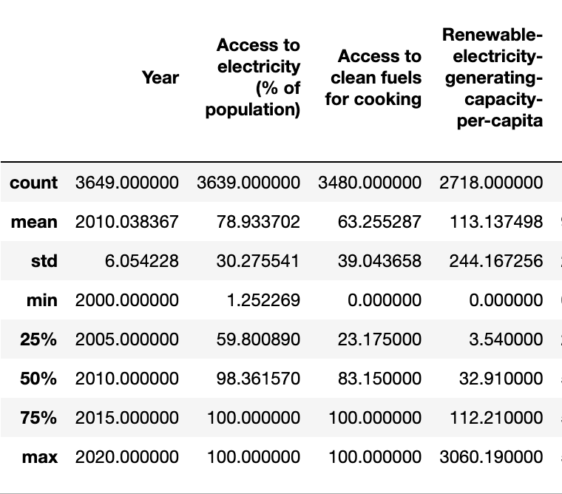
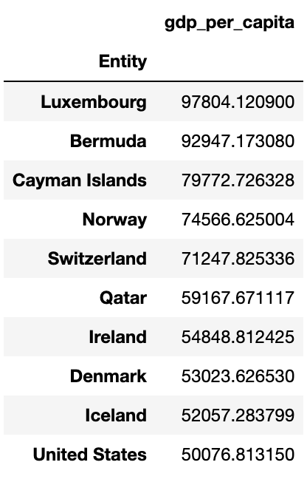
DATA CLEANING

Slide 5
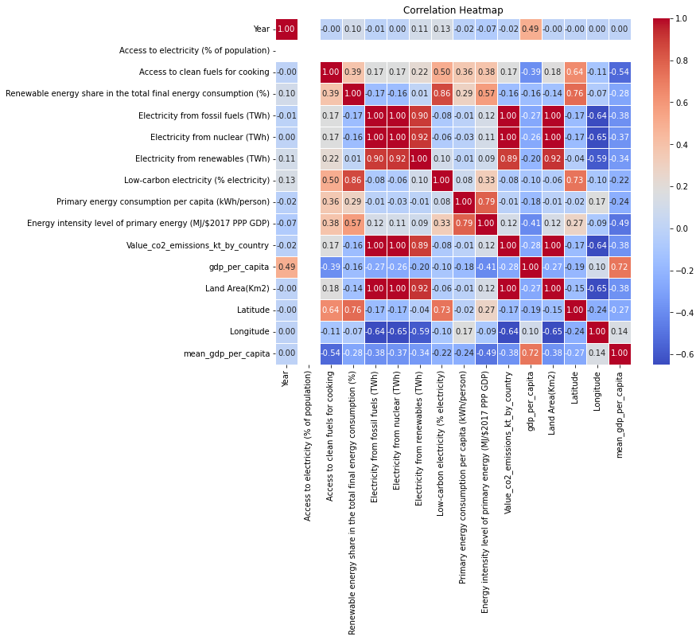
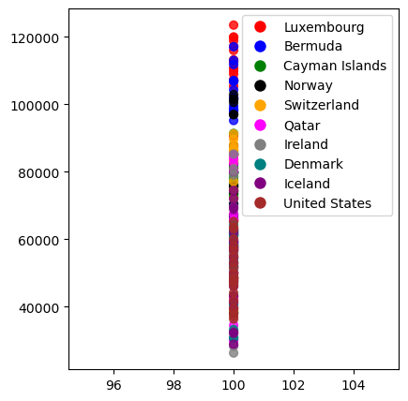
CORRELATION HEAT MAP

Slide 6
GRAPHICAL ANALYSIS
2

Slide 7
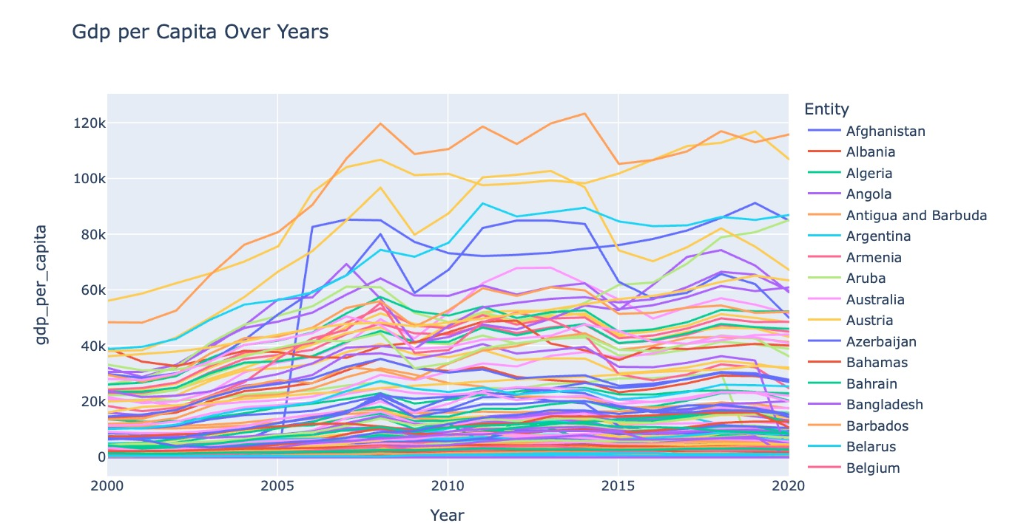

Slide 8
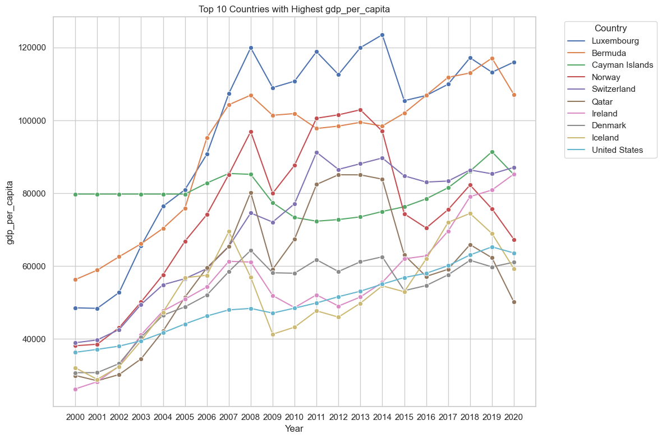

Slide 9
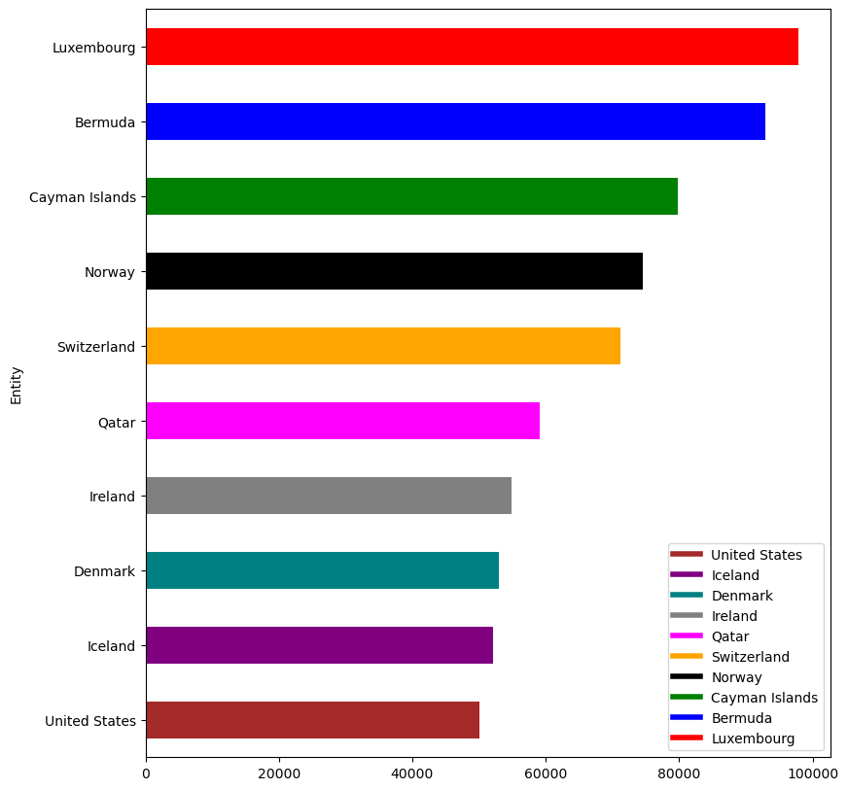
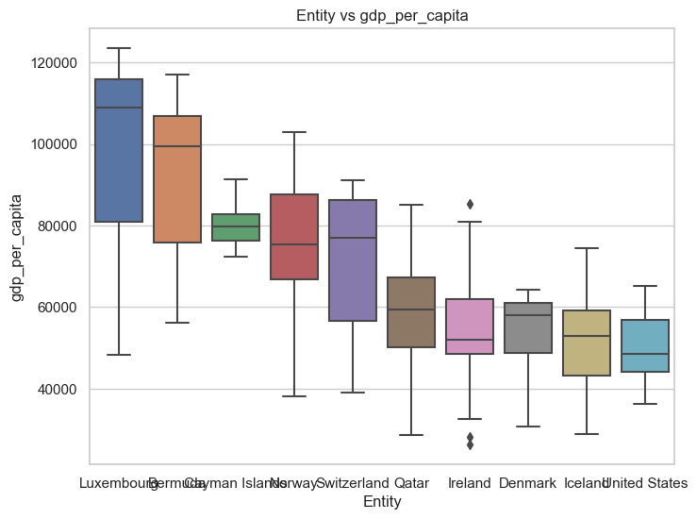
GDP PER CAPITA (TOP 10 COUNTRIES BY MEAN GDP PER CAPITA)

Slide 10
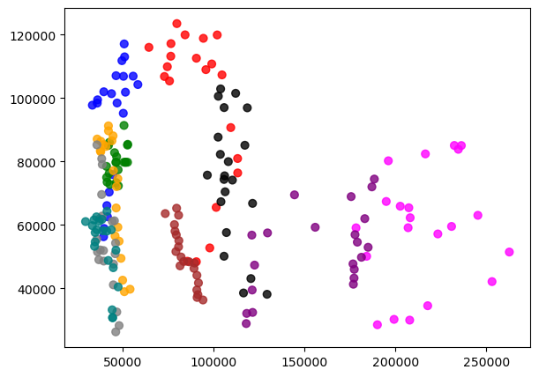
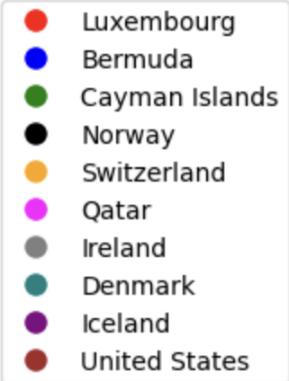
PRIMARY ENERGY CONSUMPTION PER CAPITA (kWh/PERSON)

Slide 11
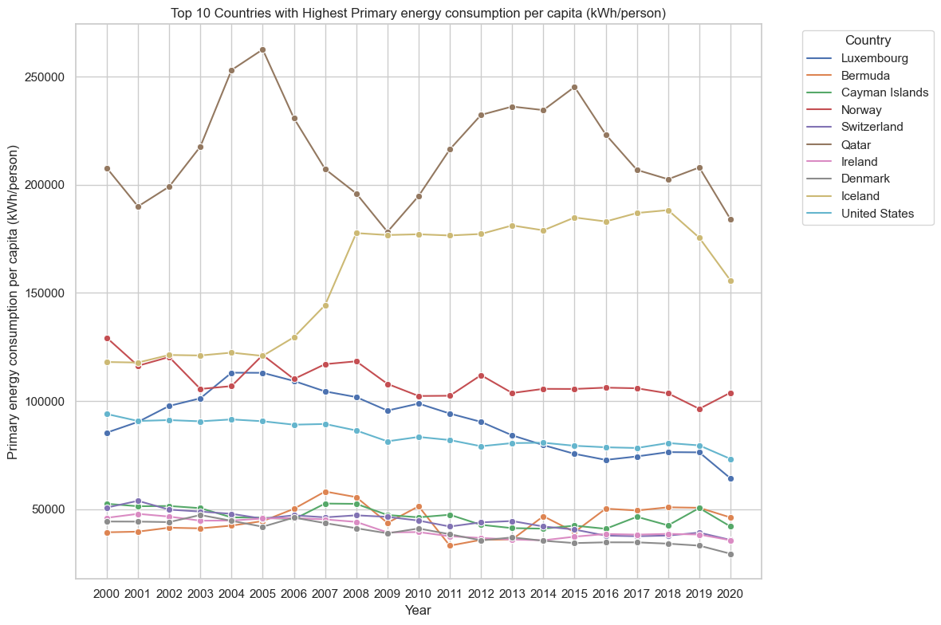

Slide 12
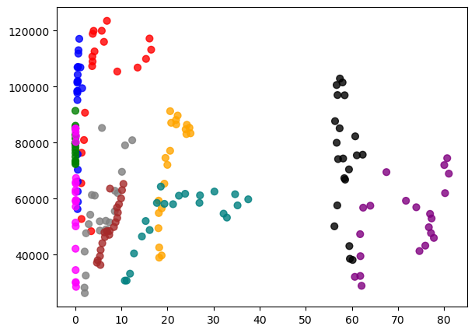
RENEWABLE ENERGY SHARE OF TOTAL ENERGY CONSUMPTION (%)

Slide 13
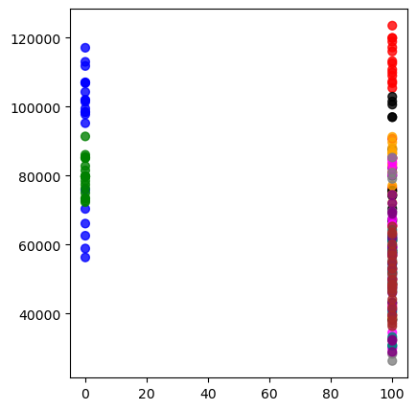
ACCESS TO CLEAN FUELS FOR COOKING

Slide 14
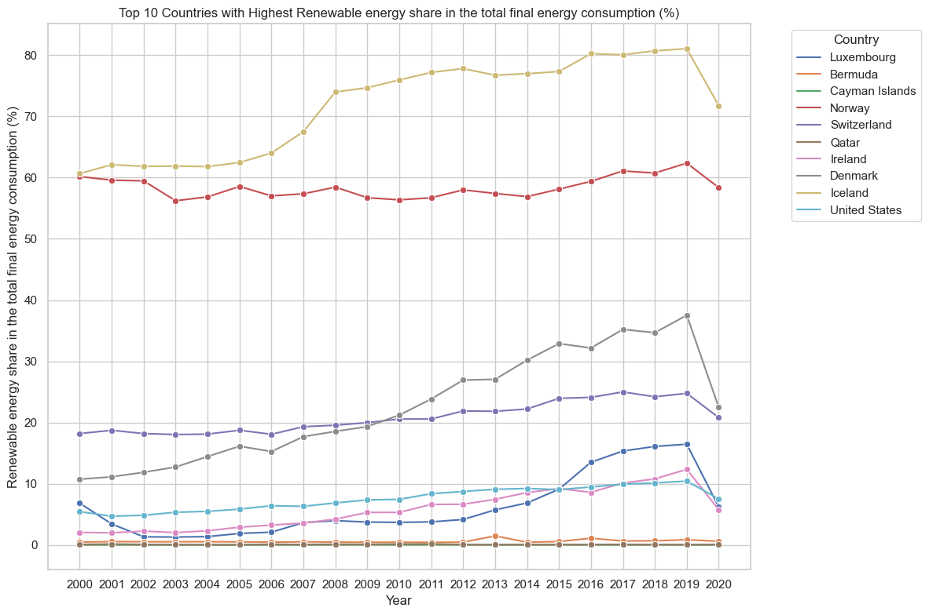

Slide 15
PREDICTIVE MODEL
3

Slide 16
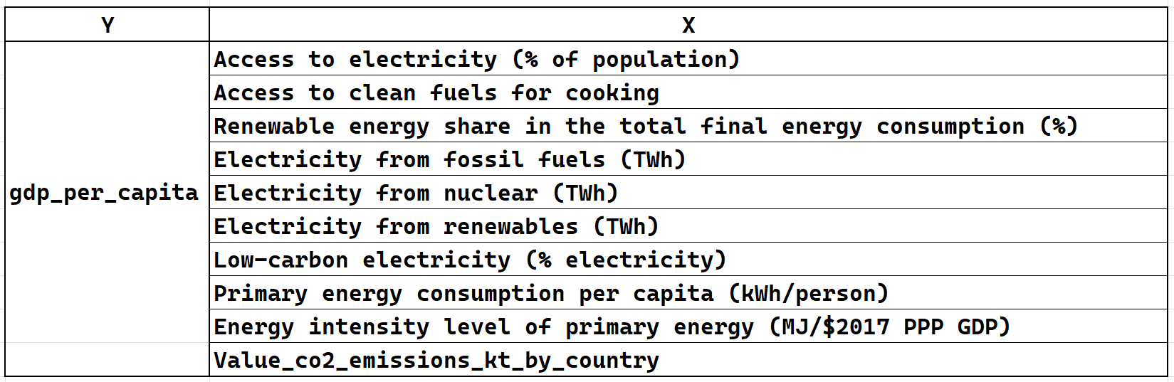
REGRESSION PREDICTIVE MODEL

Slide 17
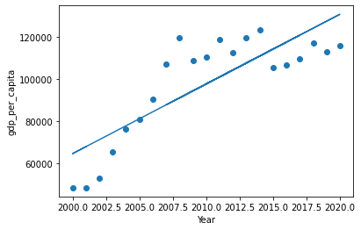
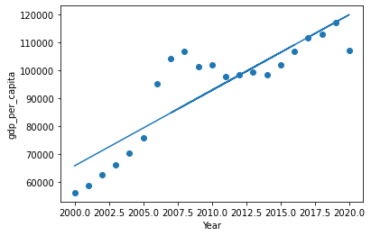
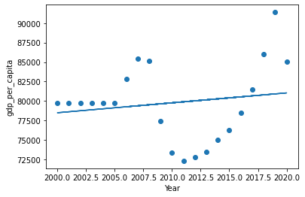
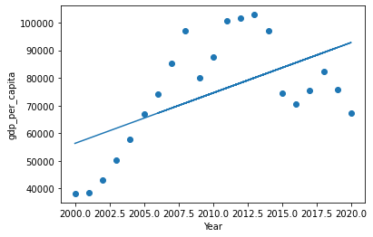
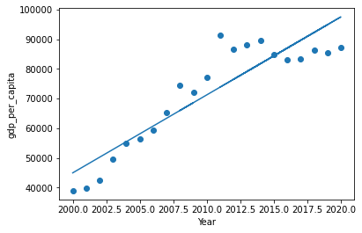

1. LUXEMBOURG
2. BERMUDA
3. CAYMAN ISL.
4. NORWAY
5. SWITZERLAND
6. QATAR

Slide 18
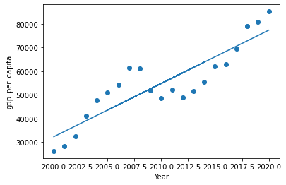
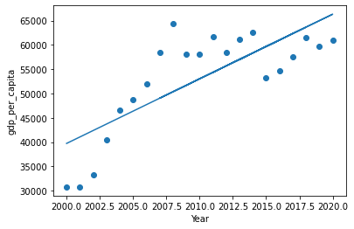
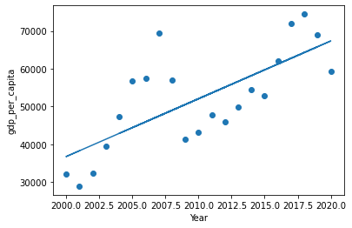
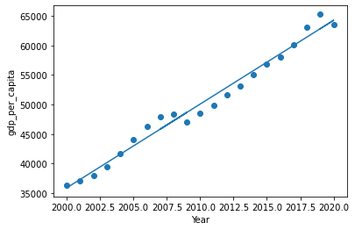
7. IRELAND
8. DENMARK
9. ICELAND
10. UNITED STATES

Slide 19


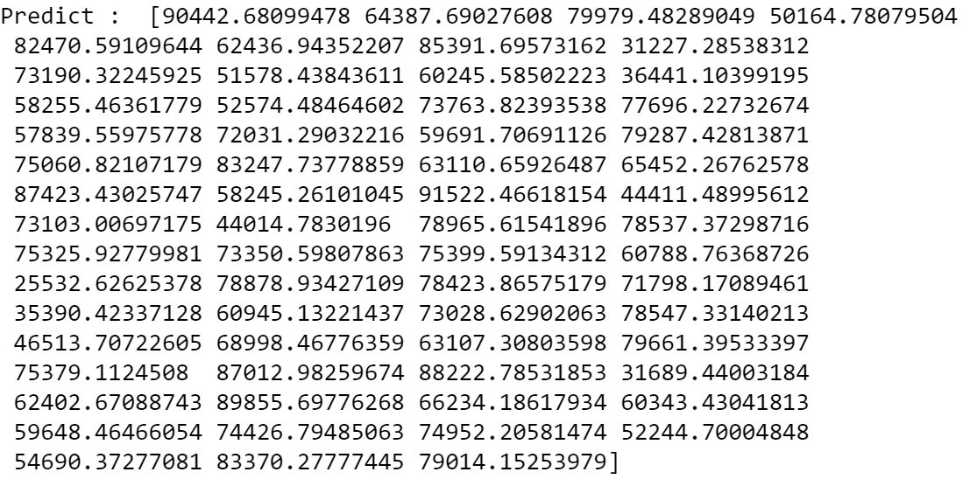
PREDICTIVE MODEL RESULTS

Slide 20
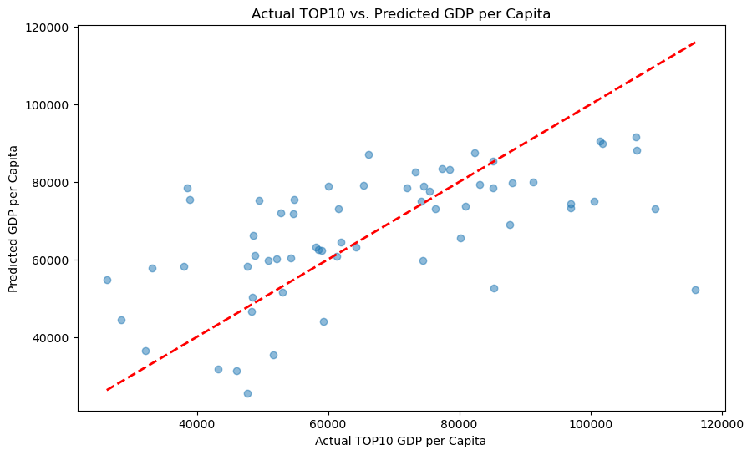
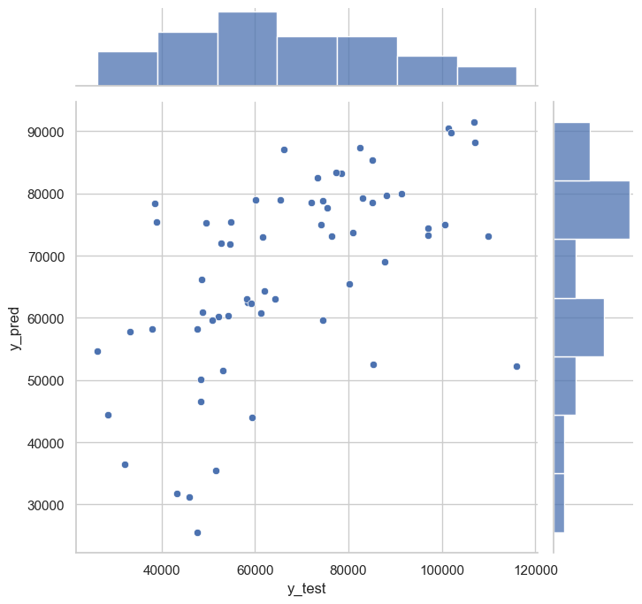

Slide 21


